Slide 1
“Sequencer”, State Notation Language SNL
Kay Kasemir,
Many slides from Andrew Johnson, APS/ANL
Feb. 2022

Slide 2
EPICS Sequencer
Implementation of the state transition control model
Transparently supports channel access connections
  Read connection state of PVs
  Get and put values
  Monitor value changes
SNL – State Notation Language
  Syntax for describing a state machine
  Generates C code and supports insertion of manually crafted blocks of code
    %% strcpy( seqg_var->stateName, "init" );
    %{
    // multiple lines of c or c++ code
    }%
  Produces compiled code

Slide 3
IOC
LAN
Database:
Data Flow,
mostly periodic
processing
Sequencer:
State machine,
mostly
on-demand
Optional:
Sequencer runs as standalone CA-Client
IOC
Channel Access
Database
Sequencer
Device Support
I/O Hardware
CA Client
Sequencer

Slide 4
State Machine 101
System is in some state
Events trigger transitions to other states
Actions may be performed on transition
State A
Transition
Event
A to B
Action
State B

Slide 5
Example
Start
Poor vacuum
pressure < 5.1 uTorr
Open the valve, update pumps, …
Good vacuum
pressure > 4.9 uTorr
Close the valve, update pumps, …

Slide 6
Example State Notation Language
state poor_vacuum
{
when (pressure <= .0000049)
{
RoughPump = 0;
pvPut(RoughPump);
CryoPump = 1;
pvPut(CryoPump);
Valve = 1;
pvPut(Valve);
} state good_vacuum
}
state good_vacuum
{
…
State
Event
Action
Transition

Slide 7
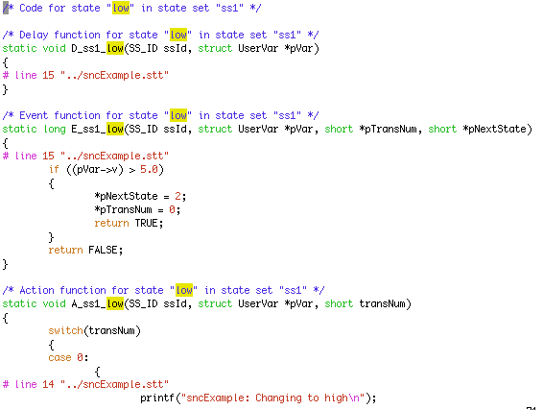
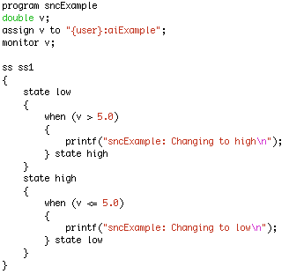
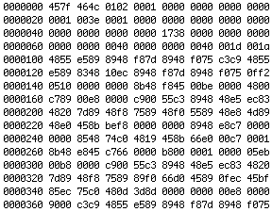
How it works
C Code
State Notation Language
“snc”
Pre-compiler
C Compiler
Object code

Slide 8
Advantage
Compiled code. Fast.
Can call any C(++) code
Easy connection to Channel Access and thus Records
  Compared to custom CA client, device support, …
Skeleton for event-driven State Machine
  Handles threading, event handling, …

Slide 9
Disadvantage
Limited runtime debugging
  See current state, values of variables,
  but not details of C code within actions
Can call any C(++) code
  and shoot yourself in the foot
Pre-compiler.
SNL error
  SNC creates unreadable C code
  Totally cryptic C compiler messages
Risk of writing SNL code
  Starts out easy
  Evolves
  Ends up as a convoluted mess

Slide 10
Should I use the Sequencer?
Good Reasons:
Start-up, shut-down, fault recovery, automated calibration
Stateful Problem
  My SNL has 20 states, 30 possible transitions, and little C code for each transition
Cannot satisfy system requirements with records
  CALC
  CALCOUT
  BO (momentary)
  SEQ
  Subroutine records
State machine purpose is to separate control flow and data flow
Bad Reasons:
PID control, interlocks
Warning sign:
  My SNL code has 3 states with 2000 lines of C code
I don’t want to deal with records,
I’m more comfortable with C code

Slide 11

Use the sequencer
For sequencing complex control tasks
E.g. parking and unparking a telescope mirror
Photograph courtesy of the Gemini Telescopes project

Slide 12
If you really want to use SNL
Good manual:
  http://www-csr.bessy.de/control/SoftDist/sequencer/
Iterate in small steps
  Code a little
  Compile, test
  Code a little more
  Compile, test
When stuck
  Bisect new code into successively smaller sections to find offending statements when diagnostic messages are overly mysterious

Slide 13

SNL Structure
Program name!
Used in DBD
&
to launch the sequence.
program SomeName("macro=value")
/* Comments as in C */
/* Options */
/* Variables */
/* State Sets */

Slide 14
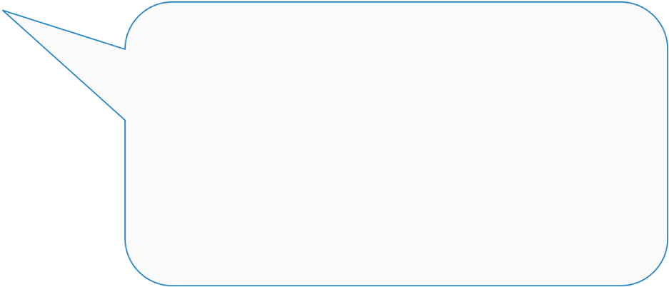
SNL Options
Make “re-entrant”.
Should be the default.
Allows running more than one copy (with different macros).
option +r;
option -c;
Start right away, do not await connections.
Even with “+c”, the default,
PVs may disconnect
once you’re running..

Slide 15
SNL Structure
program SomeName("macro=value")
/* Comments as in C */
/* Options */
/* Variables */
/* State Sets */

Slide 16
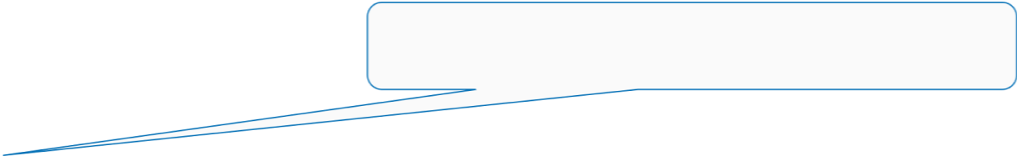
Variables
int, short, long, char, float, double
double pressure;
assign pressure to "Tank1Coupler1PressureRB";
monitor pressure;
short RoughPump;
assign RoughPump to "Tank1Coupler1RoughPump";
string CurrentState;
assign CurrentState to ”{macro}:VacuumState";
Map to channel
Update with channel
string == char[40]
Replaced w/macro’s value

Slide 17
Array Variables
Any but ‘string’
double pressures[3];
assign pressures to
{
"Tank1Coupler1PressureRB",
"Tank1Coupler2PressureRB",
"Tank1Coupler3PressureRB”
};
monitor pressures;
short waveform[512];
assign waveform to "SomeWaveformPV";
monitor waveform;
Map to channel(s!)

Slide 18

Event Flags
Declaration:
evflag event_flag_name;
Trigger on Channel Access updates
by synchronizing with monitored variable
sync var_name event_flag_name;
assign var1 “pvname1”;
monitor var1;
assign var2 “pvname2”
monitor var2;
sync var1 ef;
sync var2 ef;
Communicate events between state sets with efSet(), efTestAndClear(), ef*..

Slide 19
Event Flags
Multiple PVs may be sync’d with a
single evflag but a single PV may not be
sync’d with more than one evflag
  Allowed
    sync var1 ef1;
    sync var2 ef1;
    sync var3 ef2;
  Not allowed
    sync var1 ef1;
    sync var2 ef1;
    sync var3 ef2;
    sync var1 ef2; # offending statement – attempt to
    # sync var1 with ef1 and ef2

Slide 20
SNL Structure
program SomeName("macro=value")
/* Comments as in C */
/* Options */
/* Variables */
/* State Sets */

Slide 21
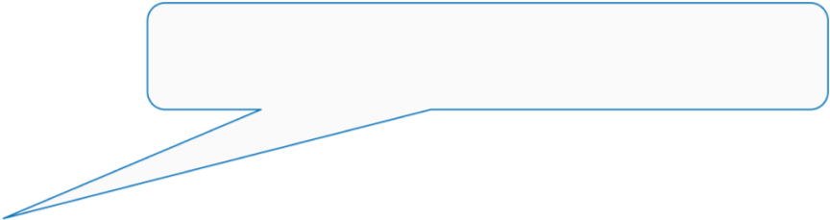
State Sets
Starts in First state,
name does not matter
ss coupler_control
{
state initial{
when (pressure > .0000051){
} state low_vacuum
when (pressure <= .0000049){
} state high_vacuum
}
state high_vacuum{
when (pressure > .0000051){
} state low_vacuum
}
state low_vacuum{
when (pressure <= .0000049){
} state high_vacuum
when (delay(600.0)){
} state fault
}
state fault {
}
}

Slide 22
Events
Variable value test
  Variables assigned to PVs and used in events MUST be monitor’ed if their values are changed by external agents alone
when (pressure > .0000051)
{
/* Actions … */
} state low_vacuum
when (pressure < 0.000051 && whatever > 7)
{
} state high_vacuum
Asynchronous pvGet or pvPut completion
when ( pvGetComplete(someVar) ) { …
when ( pvPutComplete(someVar) ) { …

Slide 23
Events..
Timer expiration
when (delay(10.0)) # This is not an unconditional delay!
{ # It is a timeout that expires only when
} state timeout # other event conditions stay false for
# the specified elapsed time
Event flags
when (efTestAndClear(some_event_flag)) …
when (efTest(some_event_flag)) …
/* Meanwhile, in other state */
when (pressure < 0.000051 && whatever > 7)
{
efSet(some_event_flag);
} state high_vacuum
Connection state changes
when (pvConnectCount() < pvChannelCount())
when (!pvConnected(some_variable))

Slide 24
Actions and Transitions
when (pressure > .0000051)
{
/* Set variable, then write to associated PV */
RoughPump = 1;
pvPut(RoughPump);
/* Can call most other C code */
printf("Set pump to %d\n",RoughPump);
} state low_vacuum
Action statements mostly resemble C code. Above, RoughPump is a state machine variable. The SNL for the printf is pre-compiled into
printf("Set pump to %d\n", pVar->RoughPump);
SNC adds pVar-> to all state machine variables.
Sometimes inserting manually crafted code blocks is necessary
%{
/* Escape C code so that it’s not transformed */
static void some_method_that_I_need_to_define(double x);
}%
(‘pVar’ is being updated to ‘seqg_var’)

Slide 25
Walk through the SNL from
makeBaseApp –t example
RELEASE.local
SNCSEQ = $.../seq-2.2.9
src/Makefile:
.._SRCS += sncProgram.st
sncExample.dbd
registrar(sncExampleRegistrar)
IOC st.cmd
seq sncExample, “user=me”
See /ics/examples/14_seqApp,
/ics/examples/iocBoot/ioc_seq

Slide 26
program sncExample
double v;
assign v to "{user}:aiExample";
monitor v;
ss ss1 {
state init {
when (delay(10)) {
printf("sncExample: Startup delay over\n");
} state low
}
state low {
when (v > 5.0) {
printf("sncExample: Changing to high\n");
} state high
}
state high {
when (v <= 5.0) {
printf("sncExample: Changing to low\n");
} state low
}
}

Slide 27
Sequencer Management and
Diagnostic Commands
seq NameOfSequence
  Start sequence
seqStop <thread id or name>
  Stop a sequence
seqShow
  List all sequences with IDs and names
seqShow <thread id or name>
  More detail for given thread
seqChanShow <thread id or name>
  List variables of seq

Slide 28
Sequencer Management and
Diagnostic Commands…
seqcar <level>
  Level 0 - show pv statuses
    Total programs=1, channels=18, connected=17, disconnected=1
  Level 1 – show disconnected pvs per program
    Program "sncExample“
    Variable "highLev" not connected to PV "one:highLevel“
    Total programs=1, channels=18, connected=17, disconnected=1
  Level 2 – show details for each pv by name
    Program "sncExample“
    Variable "systemEnable" connected to PV "one:systemEnable“
    Variable "pause" connected to PV "one:pause“
    Variable "fillTimeout" connected to PV "one:fillTimeout“
    .
    .
    .

Slide 29
More…
Support for entry and exit blocks
Assign PV names within code: pvAssign(..)
Get Callback, Put Callback
Checking status & severity of PVs
syncQ to queue received Channel Access updates
and more…

Slide 30
Summary
SNL and the EPICS sequencer is a powerful tool with a rich feature set
Very easy to implement EPICS state machines with SNL
Read the SNL manual

